Slide 1



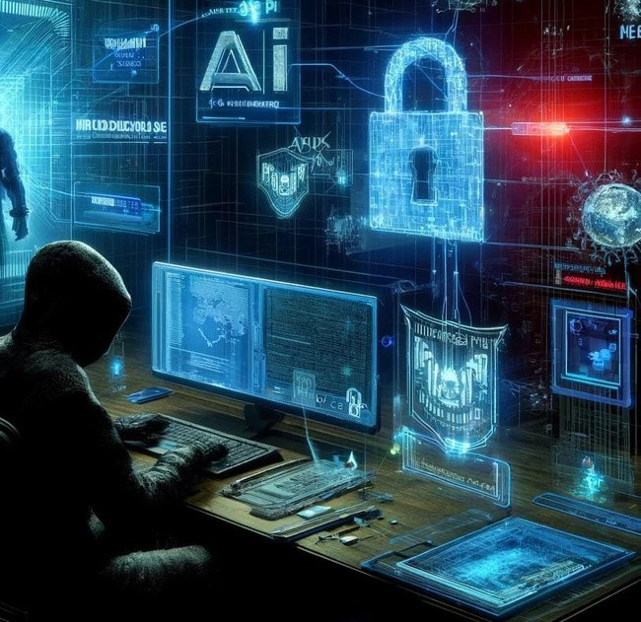
CYBER SECURITY AND AI WARFARE
Presentation by Aditya Kumar(2024UGEC040)
2024ugec040@nitjsr.ac.ic

Slide 2
Introduction
What is Cybersecurity? AI in Cyber Security.
What is AI Warfare?
Importance of understanding the intersection of both.

Slide 3
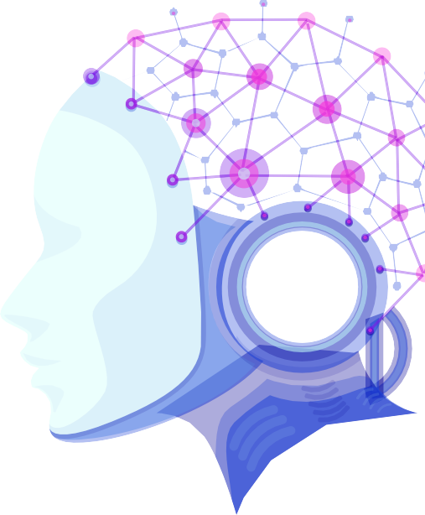
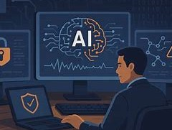
Cybersecurity Overview
Cyber security is the practice of protecting digital devices, networks, and sensitive data .
Common cyber threats: malware, phishing, DDoS attacks

Slide 4
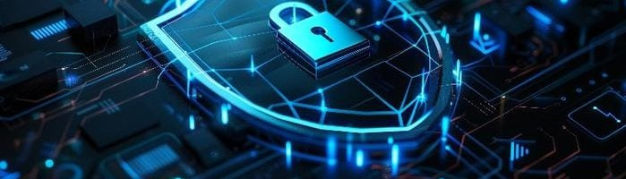
AI in Cybersecurity
Threat detection and response automation Predictive analysis and behavior monitoring AI-driven firewalls and intrusion detection systems

Slide 5
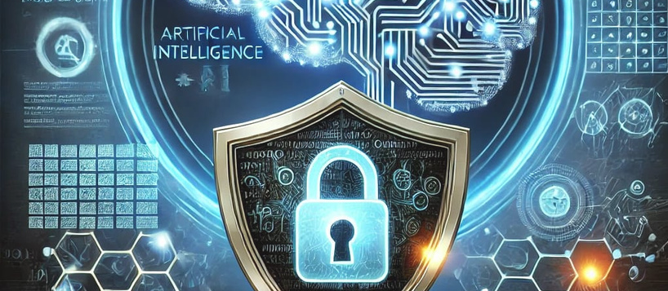
AI Warfare Explained
Use of AI in offensive and defensive cyber operations
AI-powered hacking techniques
The impact of AI-enhanced cyberattacks

Slide 6
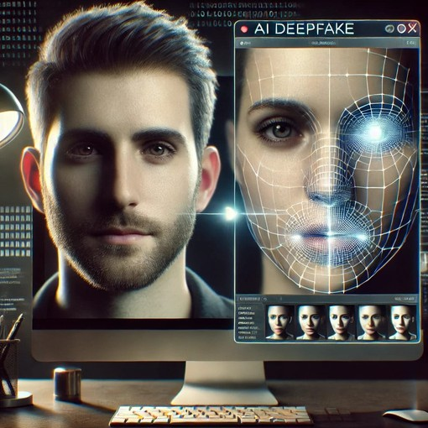
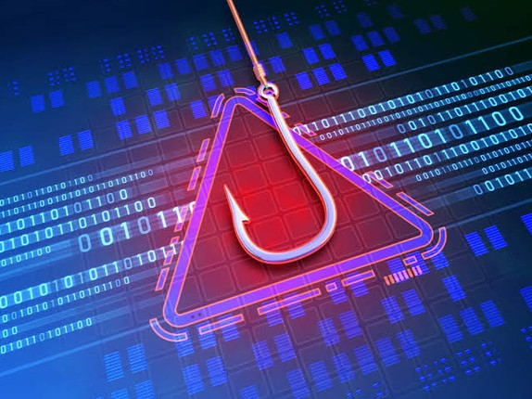
Major AI-driven Cyber Threats
Deepfake technology for misinformation
AI-generated phishing attacks Autonomous malware and botnets

Slide 7
Future of AI and Cybersecurity
Advancements in AI security tools Potential risks of AI warfare escalation Steps towards a secure AI-driven future

Slide 8
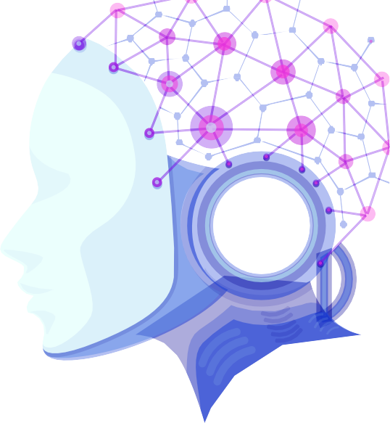
Conclusion
The digital Worl operates differently from physical world.
The need for global collaboration in AI cybersecurity
Call to action: awareness, innovation, and responsibility

Slide 9
Thank You

